Slide 1
FIFA 23 ML Project
Supervised By: Dr. Doaa Mahmoud
Supervised By: Eng. Mohamed Abdullah

Slide 2




Presented By:
LinkedIn
Github
Kaggle
Mira Ehab

Slide 3

01
Problem Definition and Introduction to the Data
CONTENTS
02
Objectives
03
Data Analysis
04
Data Preprocessing
05
Modeling
A. Predict the Position of the Player
B. Group the Similar Players
06
Deployment

Slide 4
01
Problem Definition and Introduction to the Data

Slide 5
Problem Definition and Introduction to the Data
Innovation Campus Club is a new professional football club, that wants to Compete Against the Top Clubs.
- The club board knows how Data Analysis and Machine Learning can help them learn more about the Skills that need to be in their Players, the top Clubs that they need to compete in, and the Best Position of the Players Based on their skills and know the similarity of the Players in their Team so they can create a strong team and ensure that each player will play efficiently in his Position.
Data Description:
The Data Contains:
- Every player available in FIFA 23
- 90 attributes
- Player best position, with the role in the club and in the national team
- Player attributes with statistics as Attacking, Skills, Defense, Mentality, GK Skills, etc.
- Player personal data like Nationality, Club, DateOfBirth, Wage, Salary, etc.

Slide 6
02
Objectives

Slide 7
Objectives
Help the Innovation Campus Club by:
1- Helping the club board know the best players in the different Clubs.
2- Helping them Understand their competitor’s Clubs.
3- Knowing the skills that need to be in their players.
4- Helping them put the players in their suitable Position.
5- Grouping the Club Players in Groups.

Slide 8
03
Data Analysis
Questions to be Answered :
Does the Age of the Player Affect on his Ball Control Performance?
How Height affects different factors like stamina, dribbling, pace, passing and HeadingAccuracy
Show if there is a relation between Wage and Overall of the Players
Show the top Fastest Players
Determine if their is a relation between the Position of the Player and his Wage and Value
See the Nationality of the Players that got the highest Wages
Show the effect of the Age on the Potential of the Players
View the Top 50 Players and their Clubs

Slide 9
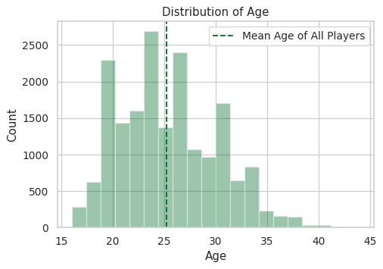
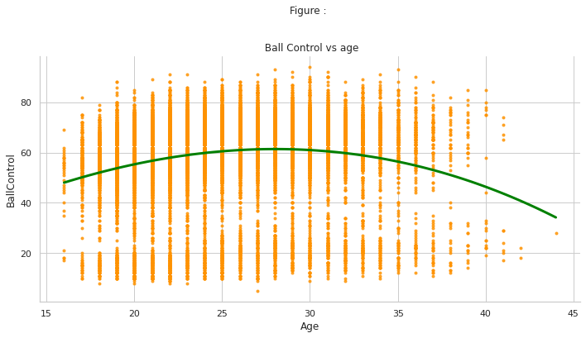
Does the Age of the Player Affect on his Ball Control Performance?
Does the Age of the Player Affect on his Ball Control Performance?
Does the Age of the Player Affect on his Ball Control Performance?
- So We can deduce that the age has an effect on the Player's Ball Control
- While the Age is increasing, the Ball Control decreases.

Slide 10
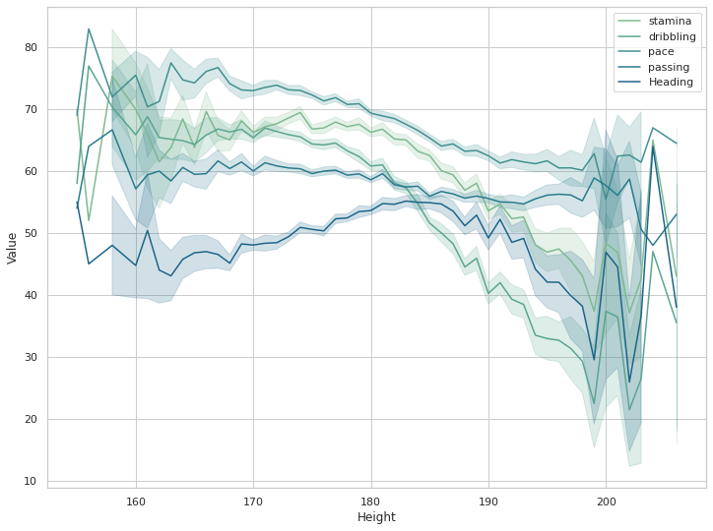
How Height affects different factors like stamina, dribbling, pace, passing and HeadingAccuracy ?
- As height increases, features like stamina, dribbling, pace, passing decreases.
- As height increases, features like Heading increase.

Slide 11
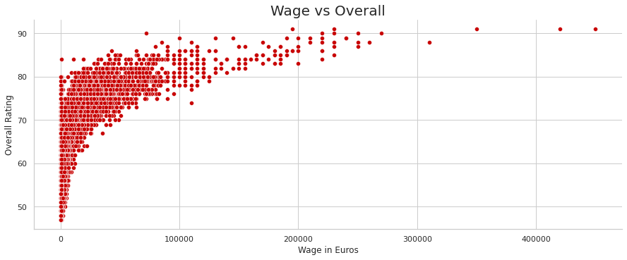
Show if there is a relation between Wage and Overall of the Players
As the Overall Rating Increase, the Wage of the Player Increases too.

Slide 12
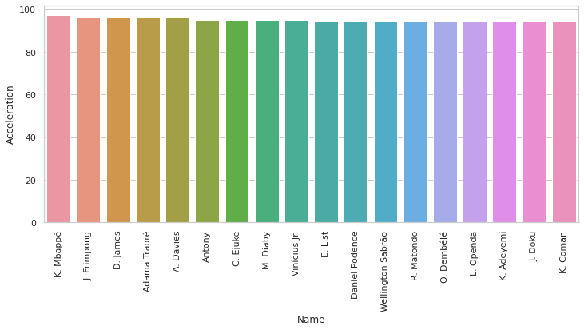
Show the top Fastest Players

Slide 13
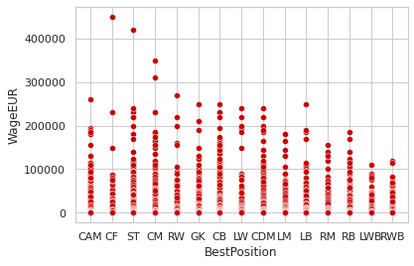
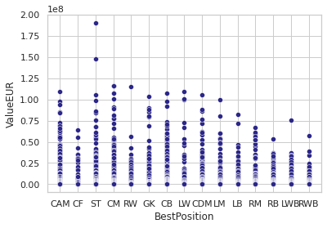
Determine if their is a relation between the Position of the Player and his Wage and Value
- So we can see that the Players in Positions LM, RM, RB, LWB, RWB got the lowest Wages.
- And the Players With Positions LB, RB, LWB, RWB, CF, RW have the lowest Values.

Slide 14
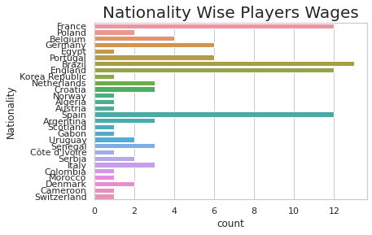
See the Nationality of the Players that got the highest Wages
So we can deduce that the Players that got the Maximum Wage are from Brazil, France, England and Spain.

Slide 15
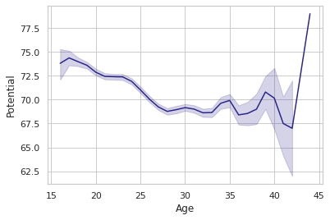
Show the effect of the Age on the Potential of the Players
While the Age Increases the Potential of the Player Decreases.

Slide 16
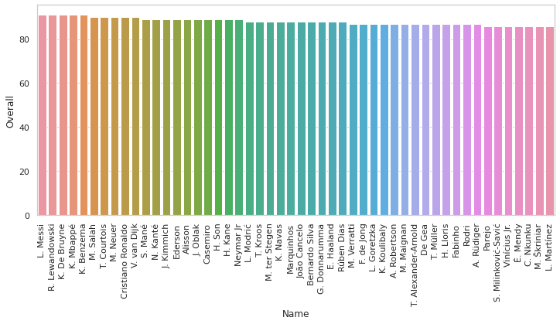
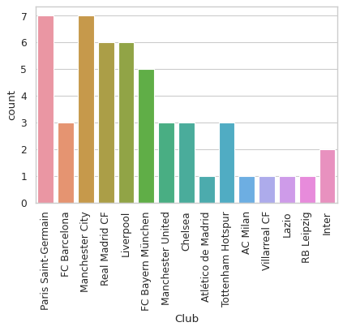
View the Top 50 Players and their Clubs
- Paris Saint-Germainand Machester City have the maximum top Players numbers
- Liverpool and Real Madrid have the second Maximum top Players numbers.

Slide 17
04
Data Preprocessing
Steps :
Handle the missing values
Handle The Categorical Columns
Handle the Imbalanced Data
Feature Scaling

Slide 18
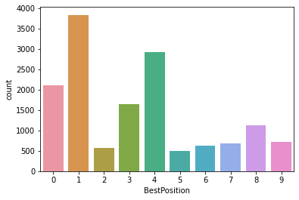
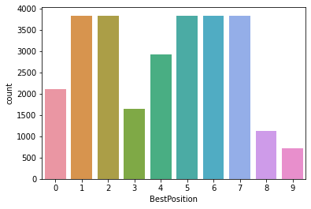
Handle the Imbalanced Data
As We can see Here the Data is Imbalanced so we need to fix this issue.
Used the Over Sampling method to Balance the classes 2, 5, 6, 7 So the model would
not be biased.

Slide 19
05
Modeling
Predict the Position of the Player Using 8 Classification Algorithms
B. Group the Players in Clusters Based on their Similarities Using 4 Clustering Algorithms

Slide 20
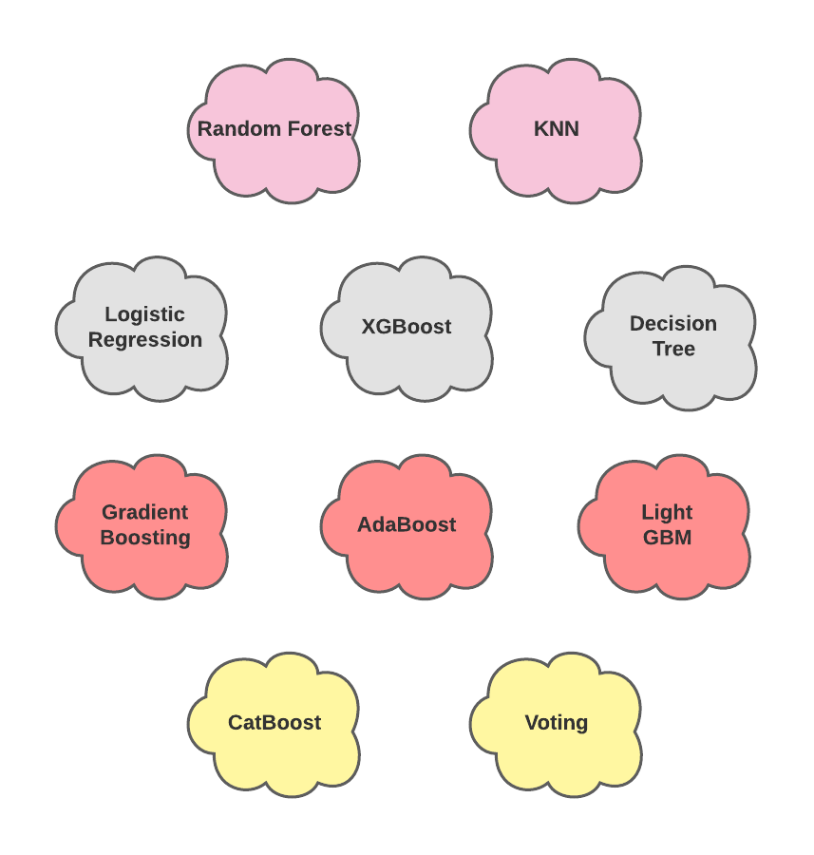
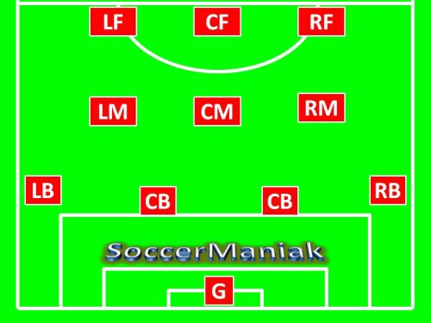
Predict the Position of the Player
Models Used:
Positions Predicted:

Slide 21
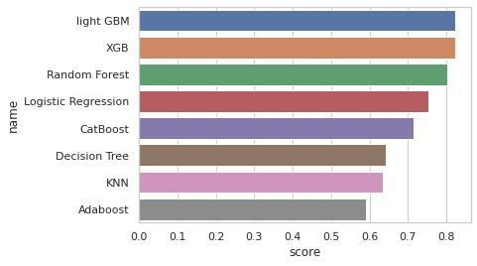
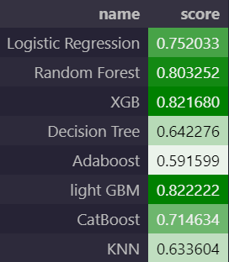
Comparing the test accuracy of the 8 Algorithms
So We Can Say that the light GBM and the XGB Algorithms are the best 2 Algorithms for that problem based on the
accuracy.

Slide 22
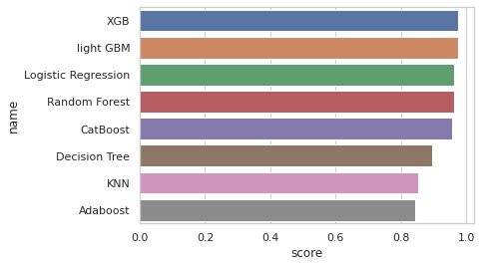
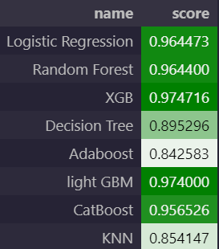
Comparing the ROC AUC Score of the 8 Algorithms
So We Can Say that the light GBM and the XGB Algorithms are the best 2 Algorithms for that problem based on the ROC AUC Score.

Slide 23
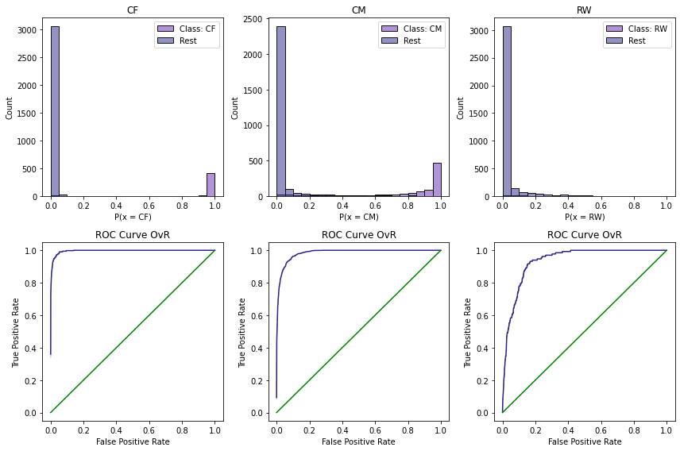
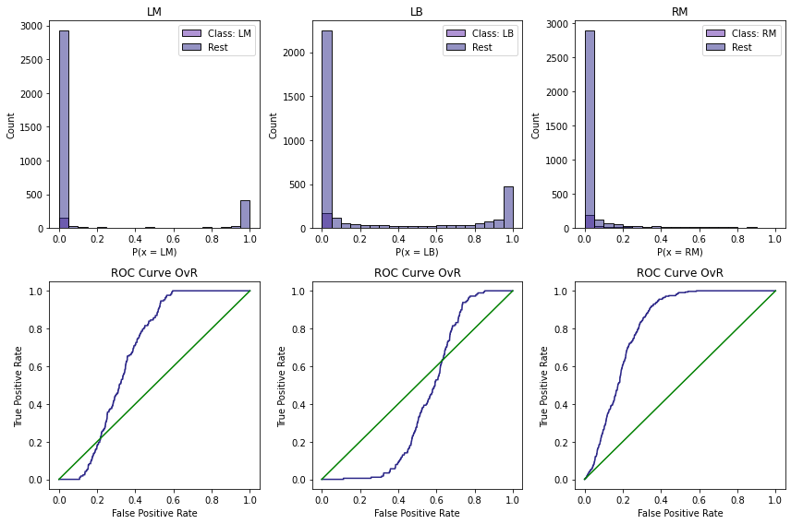
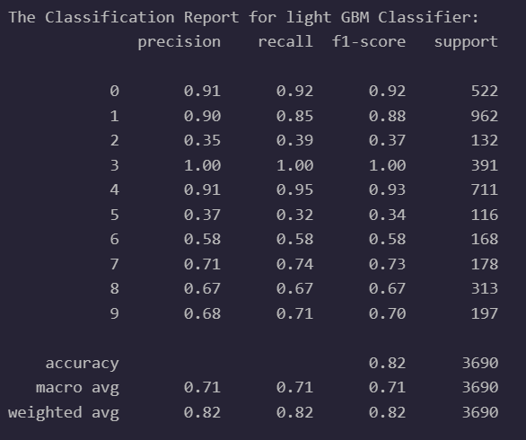
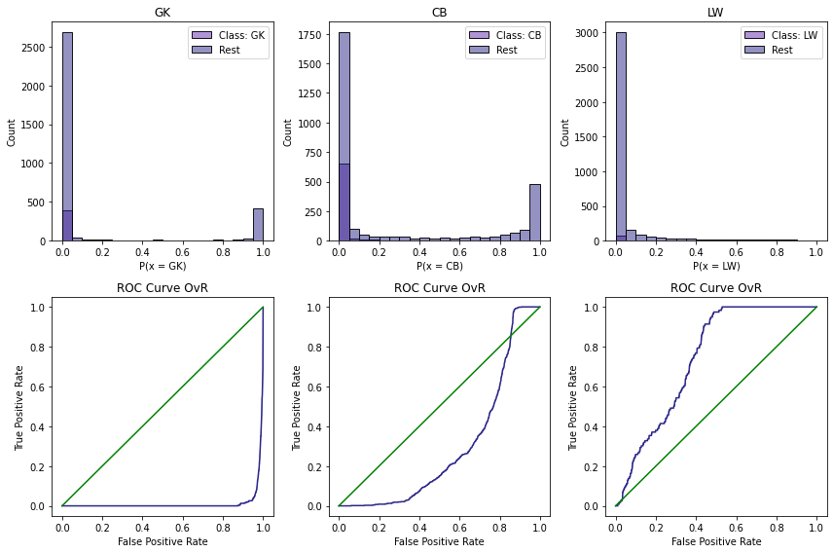
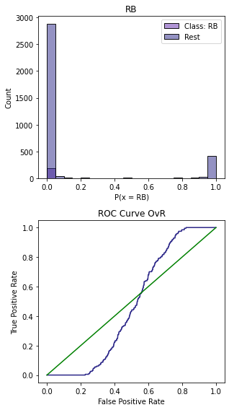
Light GBM

Slide 24
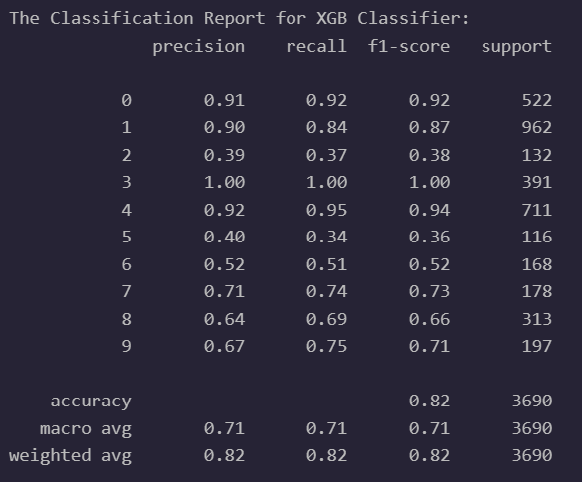
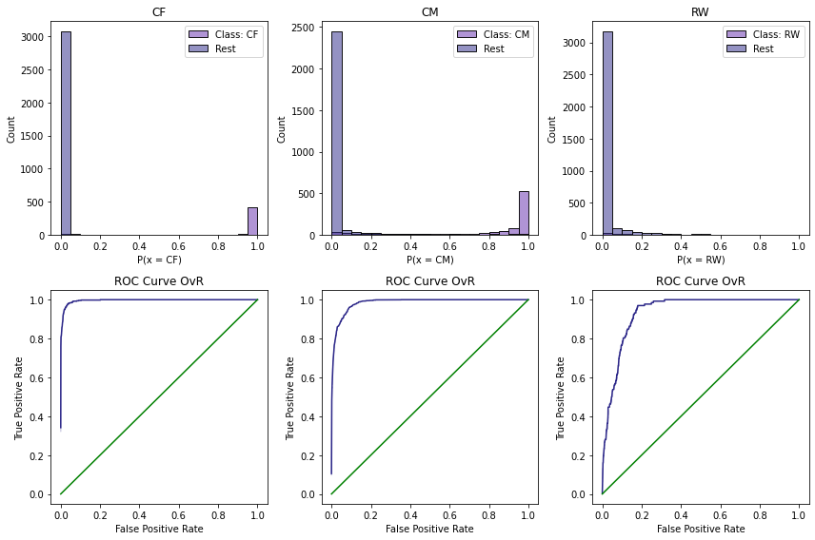
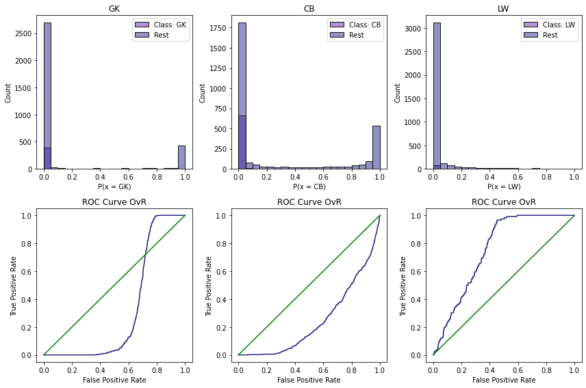
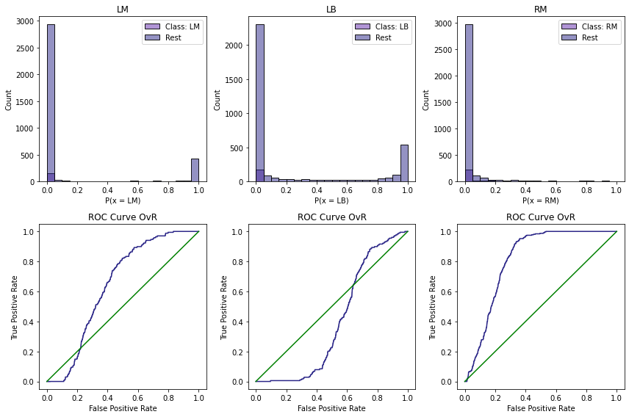

XGB

Slide 25
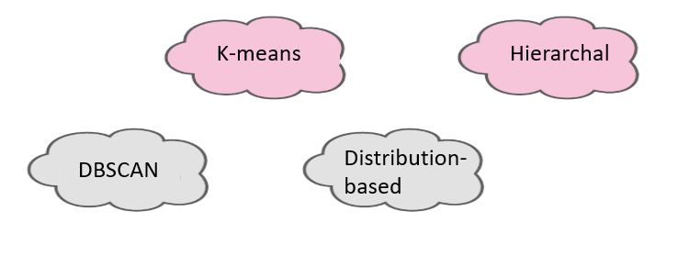
B. Group the Players in Clusters (with Overall > 86)
Models Used:

Slide 26
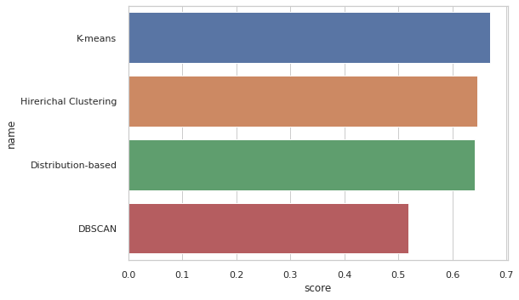
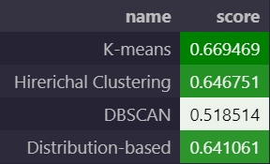
Comparing the 4 Algorithms based on the Silhouette Score
So We Can Say that the Hierarchal Clustering and the K-means Algorithms are the best 2 Algorithms for that problem.

Slide 27
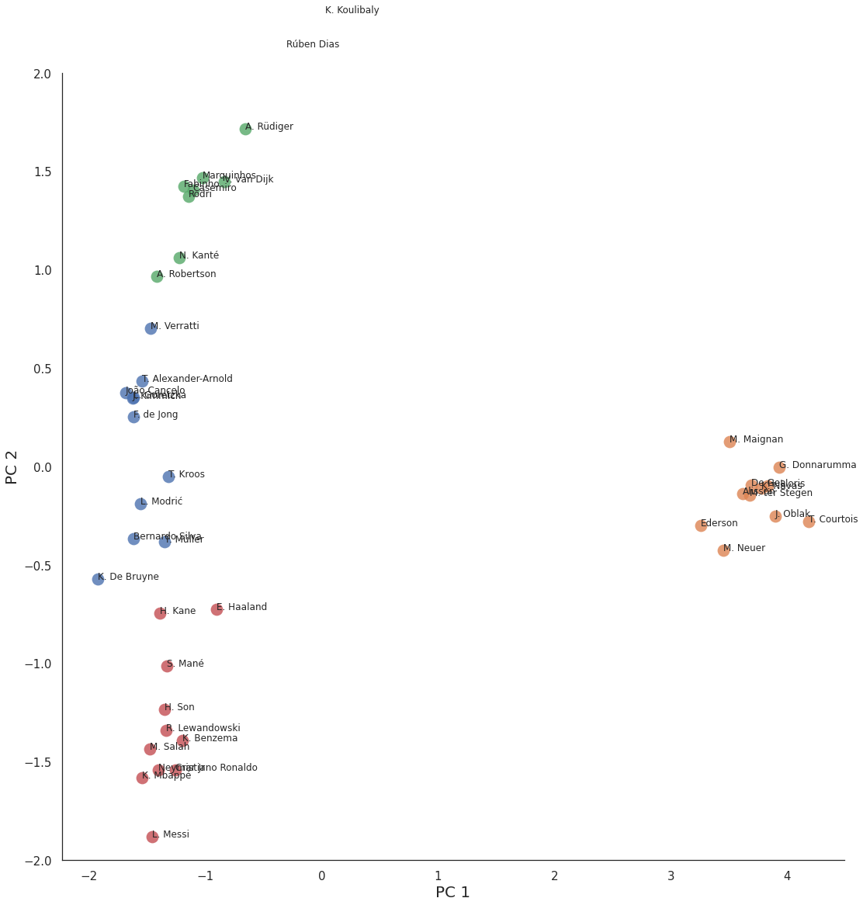
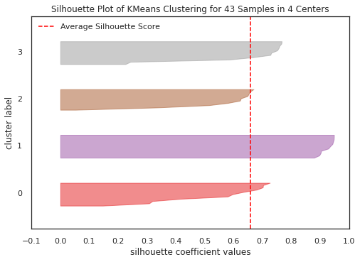
K-means

Slide 28
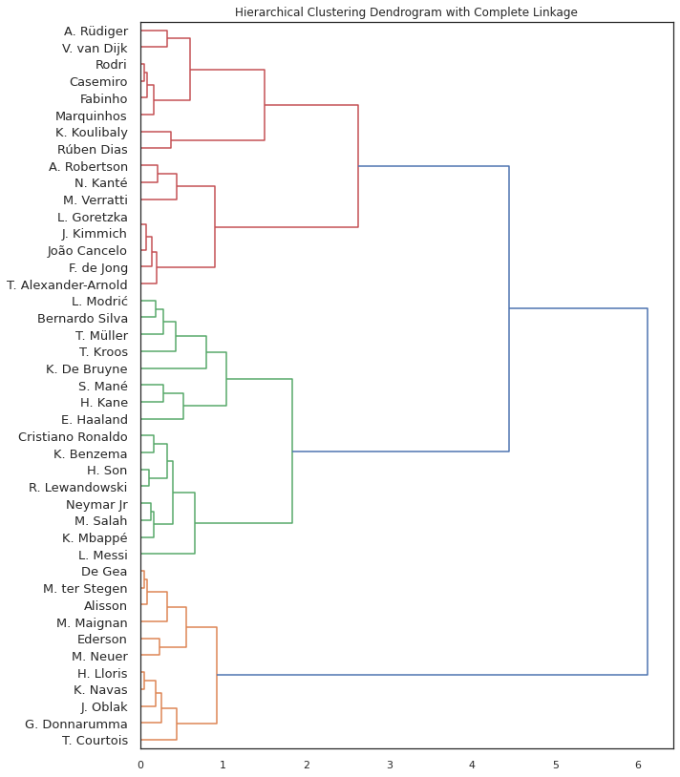
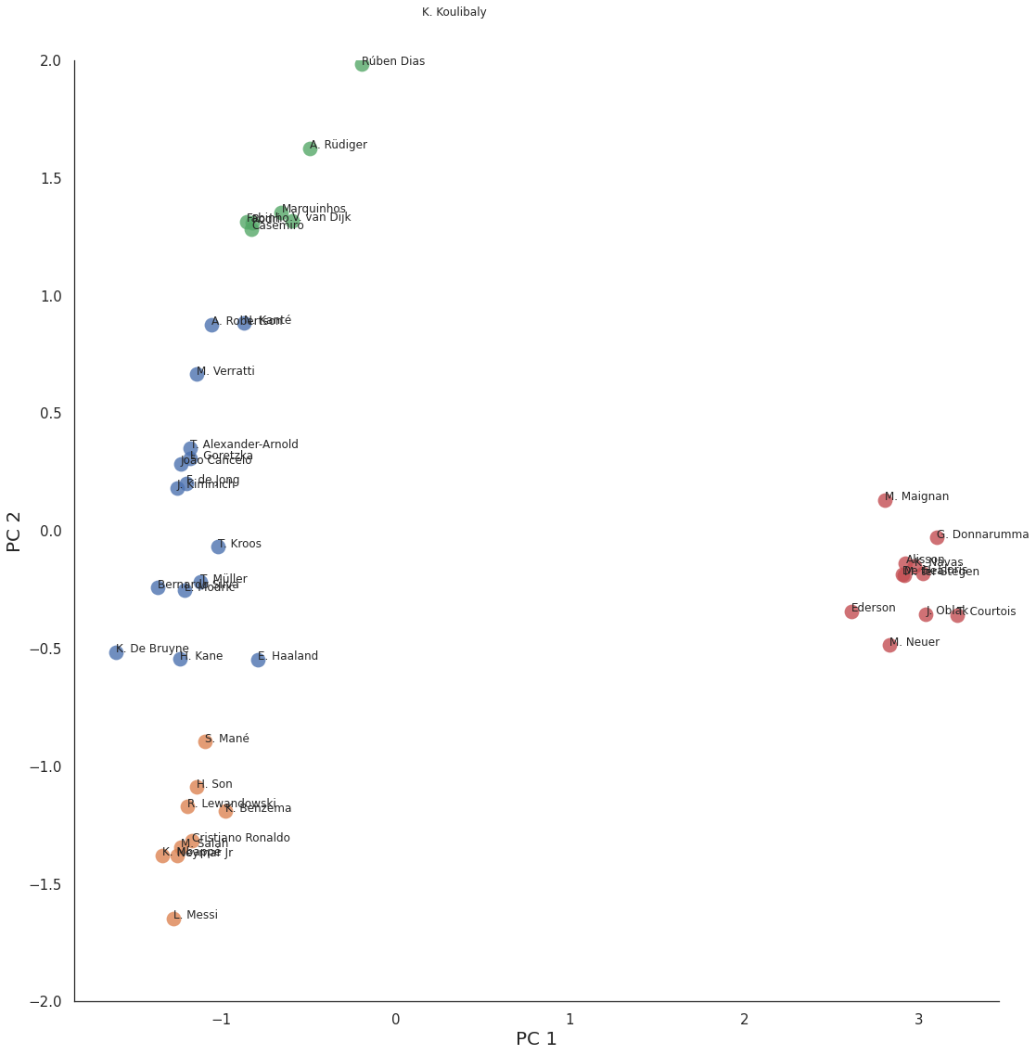
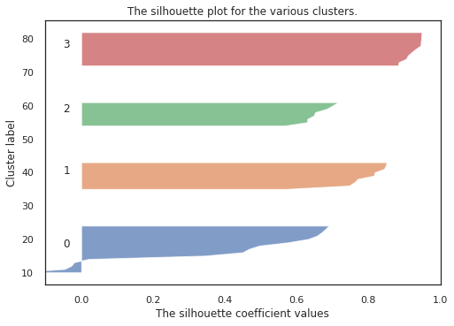
Hierarchal Clustering

Slide 29
K-means

Slide 30
06
Deployment

Slide 31


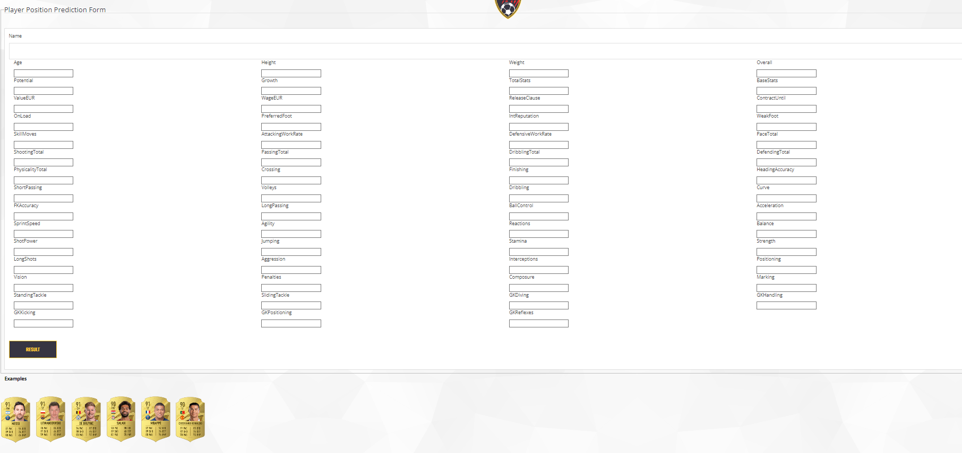

Deployment
Deployed the
Classification Model using Flask and make HTML pages to test the
predictions.

Slide 32
THANK YOU

